Slide 1
GOVT, DIGVIJAY AUTONOMOUS PG COLLEGE, RAJNANDGAON
INVITED GUEST LECTURE ON
ELECTRON SPIN RESONANE SPECTROSCOPY
Dr Mohammed Shoeb
Assistant Professor
Government Dr W.W Patankar Girls College Durg

Slide 2
Spectroscopy Techniques
Dr Mohammed Shoeb
Assistant Professor
Government Dr W.W Patankar Girls College Durg

Slide 3
Spectroscopy
Spectroscopy are a group of techniques that use electromagnetic radiations and its interaction with matter to understand its physical and chemical properties.
Spectroscopy is the study of absorption and emission of electromagnetic radiation by matter as related to wavelength of radiation.
Presently Spectroscopy also include study of the interaction of subatomic particles like Electron, Protons and Ions as function of their Collision energy.

Slide 4
Electromagnetic Radiations
Electromagnetic Radiation is composed of oscillating electric and magnetic fields that can transfer energy through space. The energy propagates as waves characterized by specific Frequency ν, Wavelength λ and Photon Energy E.
Energy of the Photon is related to its frequency by the relation E=hν
Where h is the Plank’s constant(=6.6260 x 10⁻³⁴)

Slide 5
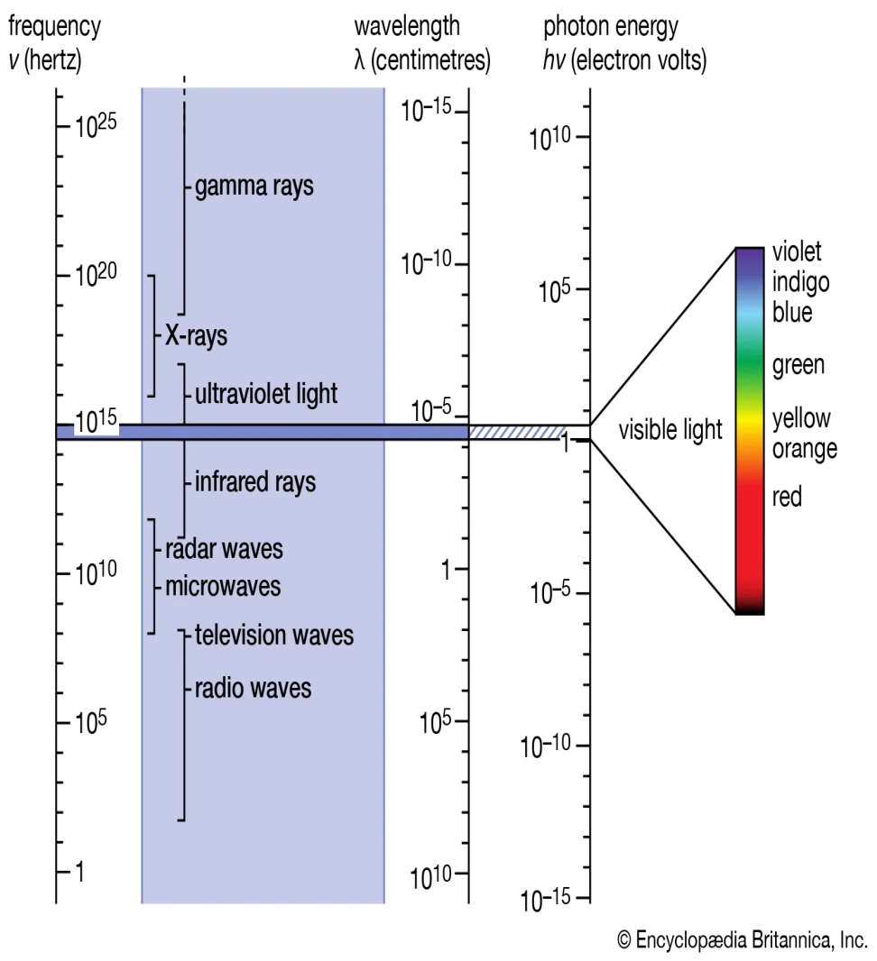
Electromagnetic Radiations
Gamma rays
X-rays
Ultraviolet rays
Visible light
Infrared
Microwave
Radio waves

Slide 6
Interaction of Electromagnetic radiation with matter
Region of the spectrum | Main interactions with matter
Radio | Collective oscillation of charge carriers in bulk material (plasma oscillation)
Microwave through far infrared | Plasma oscillation, Molecular Rotation
Near infrared | Molecular vibration, plasma oscillation (in metals only)
Visible | Molecular electron excitation
Ultraviolet | Excitation of molecular and atomic valence electrons, including ejection of the electrons (photoelectric effect)
X-rays | Excitation and ejection of core atomic electrons, Compton scattering (for low atomic numbers)
Gamma rays | Energetic ejection of core electrons in heavy elements, Compton scattering, Excitation and dissociation of nuclei
High-energy gamma rays | Creation of particle-antiparticle pairs

Slide 7
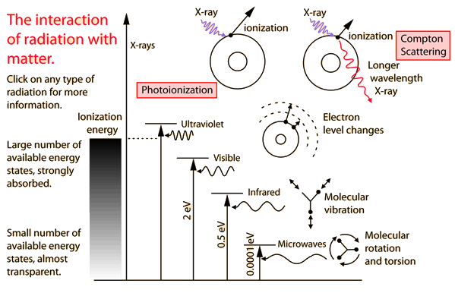
Electromagnetic radiation interaction with matter

Slide 8
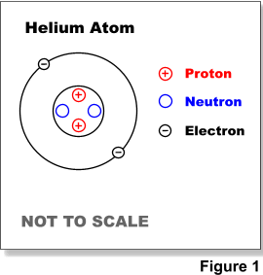
Structure of Atom
Atom consist of positively charged nucleus surrounded by a cloud of negatively charged electrons.
Nuclei are made of positively charged protons and electrically neutral neutrons held together by a nuclear force

Slide 9
Magnetic Phenomena
Magnetism arise from motion of Charged Particles
Spin of Electrons and Nucleons(Protons+ Neutrons) generate magnetic phenomena
All the electrons do produce a magnetic field
as they spin and orbit the nucleus
The direction of spin and orbit of the electron
determines the direction of the magnetic field
Two electrons spinning and orbiting in opposite directions pair up and the net magnetic moment
of the atom is zero

Slide 10
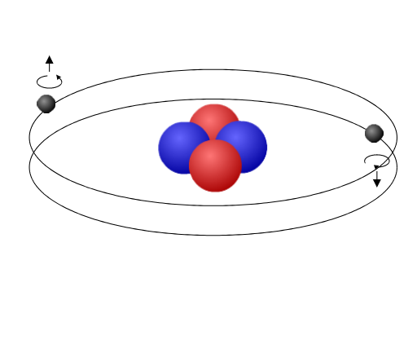
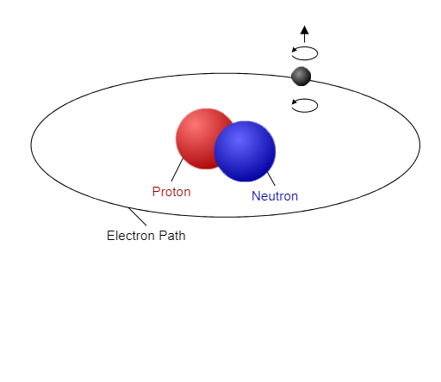
Paired electrons Cancel each ther’s magnetic field
Unpaired Electrons have magnetic field strength

Slide 11
Types of Magnetic Materials
Materials that have all paired electrons in their atoms and thus have no net magnetic moment are called Diamagnetic materials
Most materials with one or more unpaired electrons are at least slightly magnetic
Paramagnetic materials have a small, positive susceptibility to magnetic fields
Ferromagnetic materials have a large, positive susceptibility to an external magnetic field

Slide 12
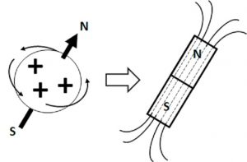
Magnetism of Nucleus
The nucleus of an atom comprises protons and neutrons, both nucleons that behave as small magnets
A “nuclear spin” is related to the sensitivity of the nucleus to the effects of external magnetic fields

Slide 13
The number of Nucleons determine which nucleus will exhibit nuclear paramagnetism
Spin | Relevant Isotopes | Common features of the nuclei/isotopes
0 | ¹²C, ¹⁶O | Nuclei composed of even numbers of protons and even numbers of neutrons
½ | ¹H, ¹³C, ¹⁵N, ³¹P, ¹⁹F, ¹²⁹Xe | Nuclei composed of odd number of nucleons (protons and neutrons)
1 | ²H, ¹⁴N | Nuclei composed of odd numbers of protons and odd numbers of neutrons

Slide 14
Resonance Condition
Two possible energy states exist for Electronic or Nuclear magnetism in presence of External Magnetic field
Low energy state E1: The field generated by spinning charged particle is parallel to external magnetic field
High energy state E2: The field generated by spinning charged particle is antiparallel to external magnetic field

Slide 15
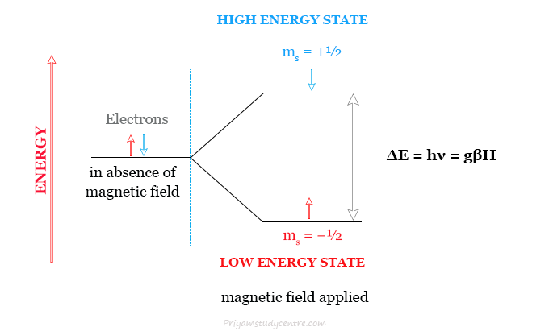

Slide 16
Resonance Condition
The resonance condition is satisfied when the transition from low to high energy states occurs due to absorption of energy
The quantum of energy required is hν , where h is planks constant, ν is frequency of radiation.
In case of Electron Spin resonance ν is in microwave region, and in case of Nuclear Magnetic resonance ν is in radiofrequency region

Slide 17
Electron Spin Resonance Spectroscopy

Slide 18
ELECTRON SPIN RESONANCE
Electron paramagnetic resonance (EPR) or electron spin resonance (ESR) spectroscopy is a method for studying materials that have unpaired electrons
Unpaired electron acts as a small magnet, which in presence of external magnetic field absorbs energy in the range of microwave region and undergoes resonance
The absorption of electromagnetic energy (at the resonance point) can be determined by keeping the frequency constant and changing(Sweeping) external magnetic field

Slide 19
Principle
The quantum of energy required to cause resonance condition and transition between energy states is related as follows:
hν=gβH
h=Planks constant
ν=Frequency
g=Spectroscopic splitting constant
β=Bohr magneton ( magnetic moment of electron)
H= Strength of magnetic feild

Slide 20
Principle
The frequency of absorbed microwave is function of paramagnetic species β and applied magnetic field strength H
Absorption of this energy is recorded as a peak and is indicative of the presence of paramagnetic species
Area under the peak is proportional to concentration of unpaired electron spins
Calibration with known standards allow concentration to be calculated
Known standards include Peroxylamine disulphonate and 1,1 diphenyl-2’picryl- hydrazyl(DPPH)

Slide 21
Principle
For delocalized electron and free radicals g=2.0023
But for localized electron g value varies and depends on nature of bonding in the environment of the unpaired electron
When resonance occurs the absorption peak broadens, due to spin lattice interactions, giving information of structure of the molecule
High resolution ESR, Hyperfine splitting of the absorption peak occurs due to interaction of unpaired electron with adjacent nuclei, giving information of spatial location of atoms in the molecule.

Slide 22
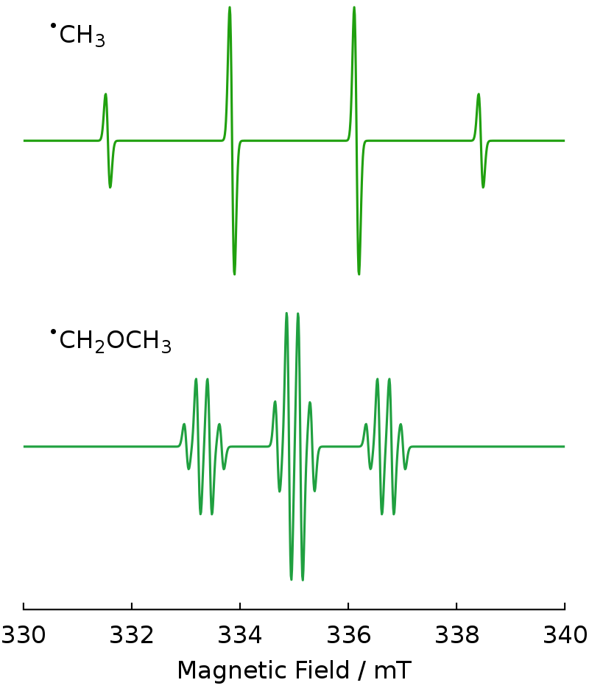
ESR Peaks

Slide 23
Instrumentation
KLYSTRONS: Klystron tube acts as the source of radiation.
WAVE GUIDE: Wave guide is a hollow, rectangular brass tube, used to convey the electromagnetic radiation to the sample and crystal.
WAVE METER is used to know the frequency of microwaves produced by klystron oscillator.
ATTENUATORS is piece of resistive metal to varying the power of the sample from the full power of klystron to one attenuated by a force 100 or more

Slide 24
ISOLATORS is a strip of ferrite material which allows micro waves in one direction only
SAMPLE CAVITIES is the resonant cavity containing the sample. Rectangular TE120 cavity and cylindrical TE011 cavity have widely been used.
CRYSTAL DETECTORS: Silicon crystal detectors, which converts the radiation in D.C has widely been used as a detector of microwave radiation.

Slide 25
MAGNET SYSTEM: The resonant cavity is placed between the poles pieces of an electromagnet. The ESR spectrum is recorded by slowly varying the magnetic field through the resonance condense by sweeping the current supplied to the magnet by the power supply.
MODULATION COIL: Creates small alternating variation of the magnetic field.
DISPLAY DEVICES

Slide 26
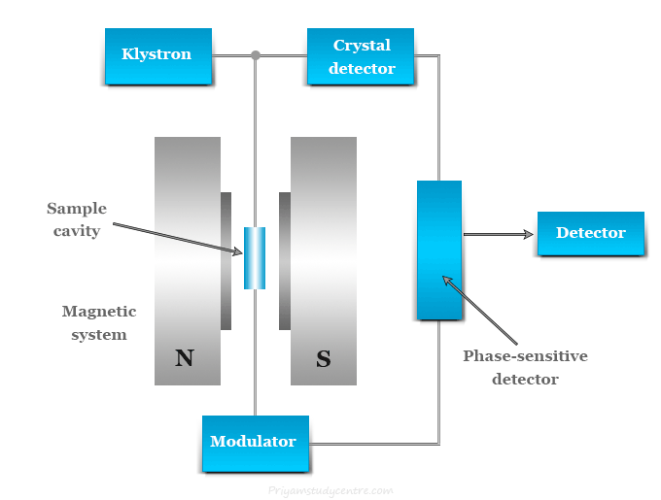
Instrumentation

Slide 27
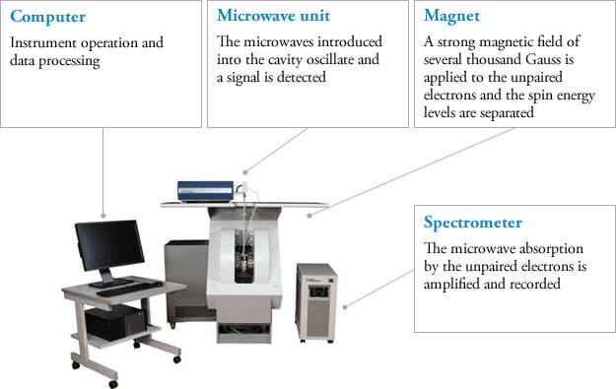
Instrumentation
https://www.jeol.com/products/science/esr.php

Slide 28
Biological Application of ESR
Metalloproteins: Metalloproteins contain metal moieties like Molybdenum(Xanthine oxidase), Copper(Cytochromes), Iron(Ferredoxin) show ESR absorption in different oxidation states. ESR can be used to study their different functional states

Slide 29
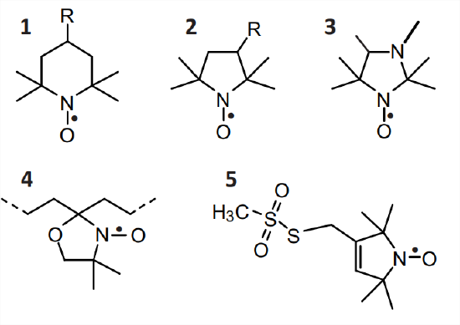
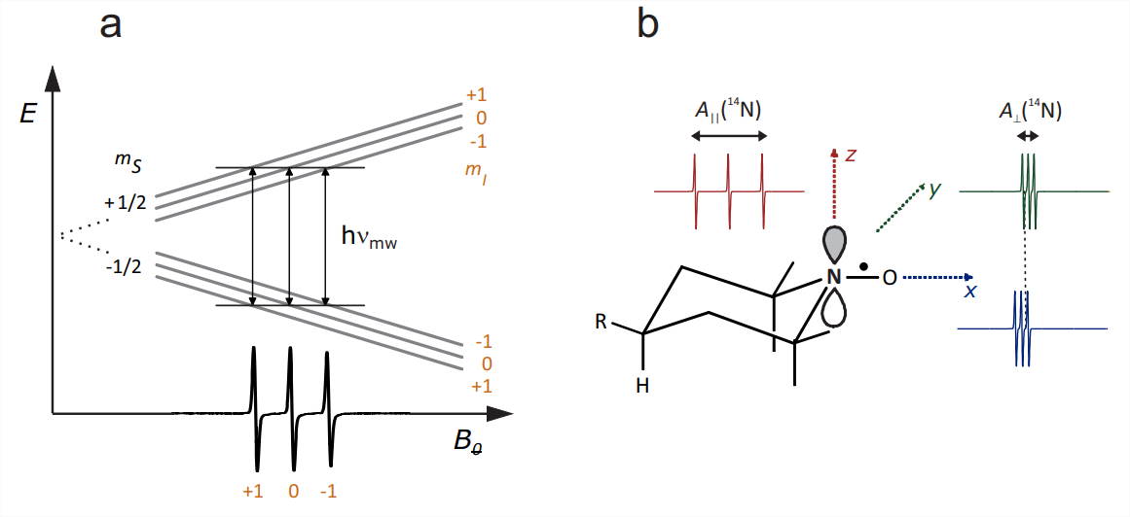
Spin Labeling
Spin labels are unreactive probes containing Nitric oxide moiety and can be used to study Lateral mobility and Anisotropic motion in biological membranes.
1 TEMPO derivatives
2 PROXYL derivatives
3 pH-sensitive imidazolidine nitroxide
4 DOXYL derivatives
5 Methane thiosulfonate spin label (MTSL)

Slide 30

Spin Trapping
Spin traps like DMPO are used to study unstable free radicals.
A common method for spin-trapping involves the addition of radical to a nitrone spin trap resulting in the formation of a spin adduct, a nitroxide-based persistent radical, that can be detected using EPR.
The spin adduct usually yields a distinctive EPR spectrum characteristic of a particular free radical that is trapped.

Slide 31
REFERENCES
http://hyperphysics.phy-astr.gsu.edu/hbase/mod3.html
https://www.nde-ed.org/Physics/Magnetism/linesofforce.xhtml
https://chem.libretexts.org/Courses/Western_Washington_University/Biophysical_Chemistry_(Smirnov_and_McCarty)/05%3A_Nuclear_Magnetic_Resonance_(NMR)_Spectroscopy_-_Introduction/5.01%3A_Nuclear_Spin_and_Magnetic_Field

Slide 32
REFERENCES
By Tungsten Einsteinium - Own work, CC0, https://commons.wikimedia.org/w/index.php?curid=102269378
https://microbenotes.com/electron-spin-resonance-esr-principle-instrumentation-applications/
https://chem.libretexts.org/Bookshelves/Physical_and_Theoretical_Chemistry_Textbook_Maps/Electron_Paramagnetic_Resonance_%28Jenschke%29/10%3A_Spin_Probes_and_Spin_Traps/10.01%3A_Nitroxide_spin_probes_and_labels

